Slide 1
Balkan Economic Analysis
Jurgen Shimani

Slide 2
Introduction
Dataset
What country has the most rapid GDP growth for the year 2024?
Does Inflation affect this GDP growth?
Does Government Expenses affect the GDP growth/reduction?
Conclusion

Slide 3

Data
The analysis combines geographical data from Natural Earth datasets (via GeoPandas) with economic indicators from the World Bank.
The Natural Earth dataset provides the country boundary data used to construct the regional map.
World Bank data supplies the economic indicators of each of the Balkan region countries.
This analysis focuses on Balkan countries, examining key indicators such as GDP growth, inflation, and government expenses.

Slide 4
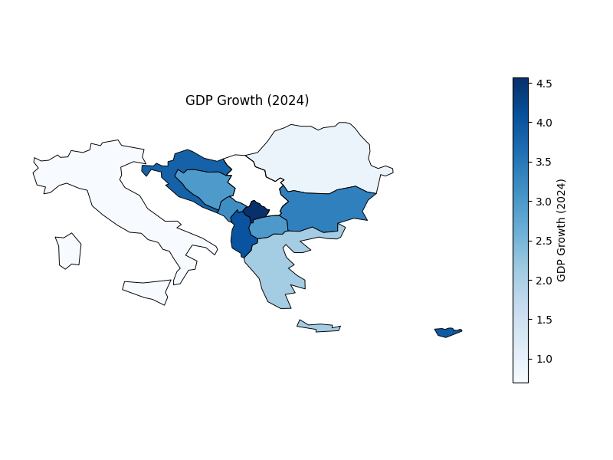
What country has the most rapid GDP growth for the year 2024?
In recent years, some Balkan countries have experienced stronger economic growth than others, partly driven by tourism and lower costs of living.
Many travelers and businesses are shifting from more expensive and well-established destinations, to more affordable alternatives in the region.
As shown in the color-coded map, Kosovo has experienced the highest GDP growth, partly due to economic recovery following the end of the territorial war with Serbia.
Albania shows the second-highest growth, supported by increasing tourism and the presence of foreign businesses, like Deloitte, etc.
In contrast, countries such as Italy and Greece, despite being part of the EU and historically having stable economies, have recently experienced slower or stagnating growth for various economic reasons.

Slide 5
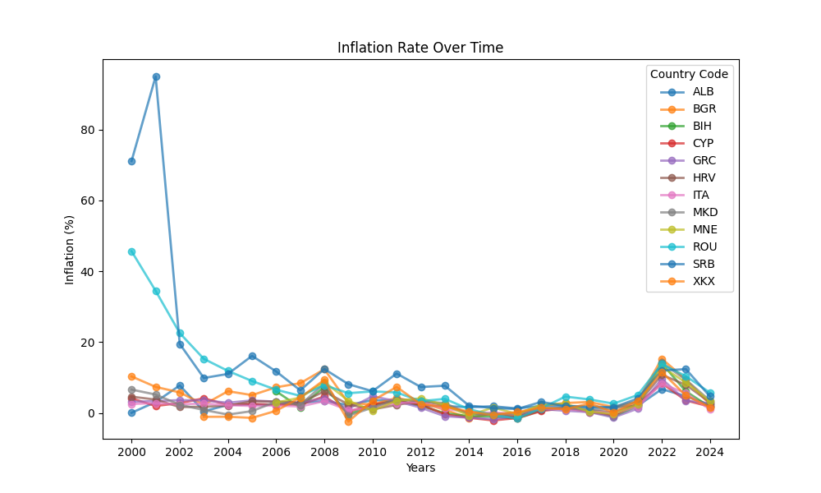
Does Inflation affect this GDP growth?
The economies of several Balkan countries have changed significantly compared to previous decades.
Smaller countries such as Albania and Kosovo experienced strong GDP growth in 2024, while maintaining relatively moderate inflation levels.
Historically, Albania experienced high inflation during the post-communist transition, but inflation has stabilized in recent years.
Recent data suggests that inflation levels across all Balkan countries have become relatively similar, indicating that GDP growth does not necessarily lead to lower inflation across all countries.

Slide 6
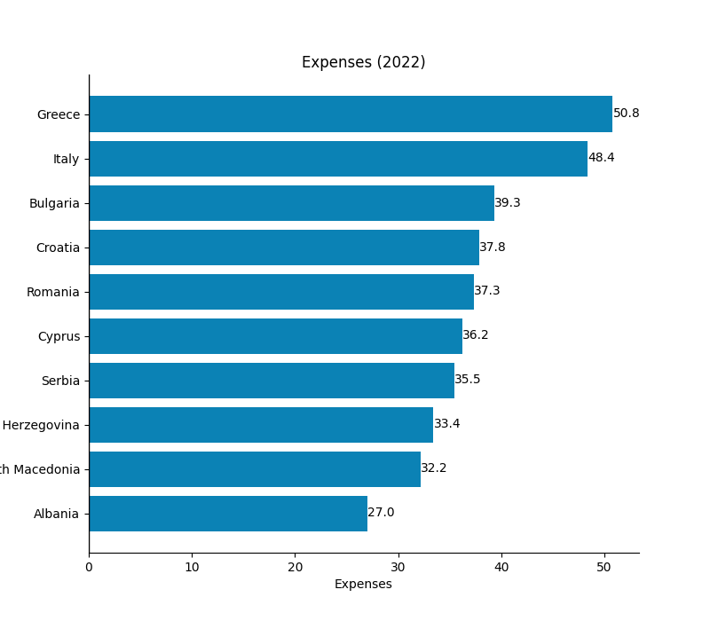
Does Government Expenses affect the GDP growth/reduction?
The graph shows that government expenses are highest in Greece and Italy, two countries that currently experience relatively low GDP growth.
In contrast, Albania, which has seen strong GDP growth in the recent years, has comparatively lower government expenses.
Lower public spending may contribute to lower costs of living and operating businesses, making the country more attractive to foreign investment and tourism.
However, the data also shows exceptions. For example, Croatia has relatively high government expenditure while still maintaining strong GDP growth, indicating that lower expenses alone do not necessarily lead to higher GDP growth.

Slide 7
Conclusion
The Balkan region has experienced different economic trends across countries, with some smaller economies showing faster growth than larger, more established ones.
Tourism, lower cost of living, and foreign business activity appear to play an important role in driving GDP growth in countries such as Albania and Kosovo.
Inflation across Balkan countries has become relatively stable and similar in recent years, indicating that higher GDP growth does not always correspond directly to lower inflation.
Government spending varies significantly between countries, and the relationship between public expenditure and GDP growth is not always consistent.
Overall, the data suggest that multiple factors, including tourism, investment, cost of living, and government policy, contribute to economic performance in the Balkan region.

Slide 8
Thank you for your attention!

